Slide 1
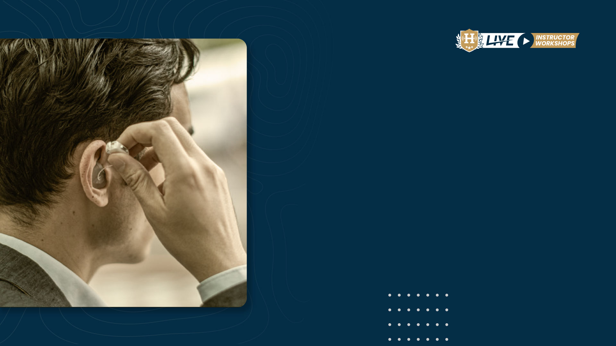
The Approach
Who are you? What do you want?
August 24, 2021

Slide 2

Last week Todd Allen described the intake process
How to “establish a bond” by humanizing yourself
How to establish yourself as the expert in treatment
How to use a “collaborative” approach for successful outcomes.
This week we will define the candidates you will be encountering and suggest methods to customize treatment for their desired communication outcomes.

Slide 3
A collaborative approach for the sales process is very effective and necessary.
Last week, Todd made the case that the consumer will wait and suffer with hearing loss for seven years before approaching you as a potential customer.
If you are not successful with your approach and counselling, your potential patient/client will remain without treatment for another five years.

Slide 4
A patient/client counseling approach is quite successful in the collaborative sales process.
Within the interview portion of last week’s presentation, a very important question was presented i.e., “have you ever worn hearing aids?”
You must differentiate your collaborative—patient/client counseling approach based upon the answer to this question.
Whether you are advertising your clinic offerings and services, or interviewing the customer, you must identify the distinction between users or non-users
I prefer to define these differences in approach as a distinction between virgins and recycles.

Slide 5

Counseling & Listening
Counseling is the gathering of data through:
Careful listening
The conveying of information
Adjustments of one’s strategies based upon the collected data/knowledge

Slide 6
Humans tend to have a more difficult time listening than they do speaking—perhaps that is why they were created with two ears and only one mouth!

Slide 7
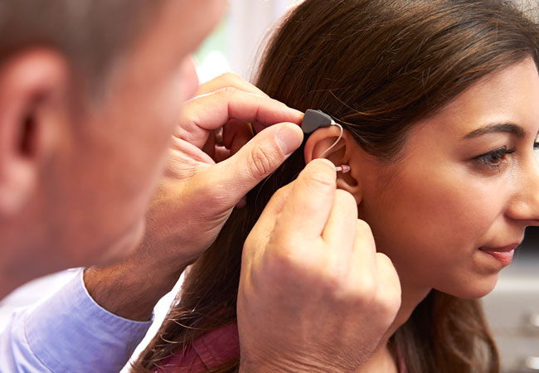
HI Market Penetration
If the ultimate objective of the dispensing professional is to help the deaf and hearing impaired hear and communicate better, and market penetration has hovered around twenty percent over the past three decades, then we must investigate and answer the question—WHY?

Slide 8
HI Market Penetration
To answer this question, we must describe the factors which result into a successful hearing instrument fitting/sale.

Slide 9
HI Market Penetration
Among the most important factors for a successful dispensing outcome are:
The hearing instrument(s)
The selection & fitting procedures
Attributes of the dispensing professional
Characteristics of the patient/client
Expectations of the patient/client

Slide 10
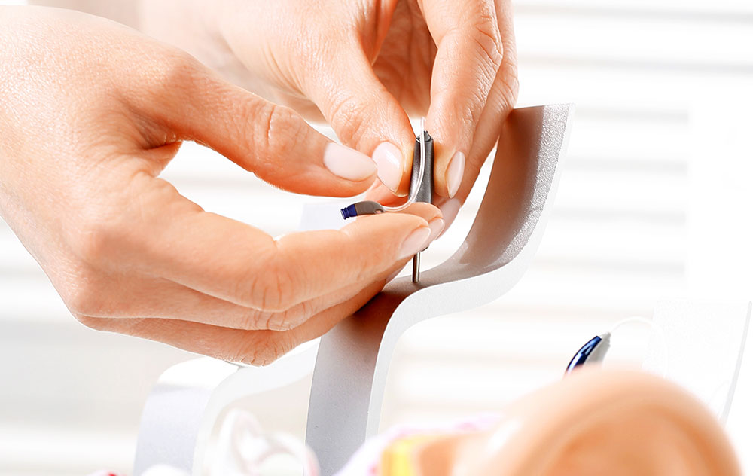
HI Market Penetration
If we assume that the products and selection & fitting procedures have improved, yet ultimate satisfaction & market penetration have not; then it stands to reason that either the characteristics of the professional and/or the patient/client have diminished, or the expectations of the patient/client have risen to an unrealistic level.

Slide 11
HI Market Penetration
We can have all of the state-of-the-art equipment and all of the sophisticated products at our fingertips, but if we cannot effectively interface amplification with enhanced communication strategies or convey information in a manner that patient/clients understand, then we have failed in our job performance.

Slide 12
HI Market Penetration
Perhaps we are so enamored with today’s sophisticated digital technology that we have lost sight of the TRUE objective?
The art of collaborative counseling is often an overlooked element in the total aural rehabilitation equation—it may just be the most important component of all!

Slide 13

Patient/Client Counseling
In healthcare, there are two main approaches towards counseling.
They are:
The professional-centered approach
The patient/client-centered approach

Slide 14
The Professional Approach involves activities such as:
The professional asks the questions
The professional is in control
The professional will diagnose and reach conclusions
The professional will make decisions regarding the patient/client needs
The professional is responsible for all decisions

Slide 15
The Patient/Client-Centered Approach involves activities such as:
Empathetic listening
Unconditional positive regard
Counselor congruence
Listening with concern

Slide 16
Many patient/clients prefer the Professional Approach.
However, one major problem with this approach is that often, the patient/client never has the opportunity to “take ownership” for their condition.
They will always place any failure upon the shoulders of the professional and/or hearing instrument(s).

Slide 17
The patient/client-centered approach may be characterized by the number of words not spoken by the dispensing professional.

Slide 18
Patient/Client Counseling
Knowledge is imparted based upon the patient/client’s needs—not the professional’s
The patient/client is empowered to make decisions
The patient/client should be encouraged to make decisions, with the goal of getting them to ask you to make the decision.

Slide 19
Patient/Client Counseling
The Patient/Client Centered Approach requires LISTENING on the part of the professional.
The first rule of counseling is LISTENING.
The patient/client’s comments and reactions should dictate the professional’s flow of counseling.

Slide 20
The session can be “damaged” if the patient/client believes you are not really LISTENING to them!

Slide 21
Patient/Client Counseling
Following are some suggestions to demonstrate your attentiveness:
While making notes, do not loose contact with the patient/client
Do not ask questions they have already answered
Use a questionnaire or expectation survey
Let the patient/client know you are truly listening by occasionally rephrasing their statement

Slide 22
Patient/Client Counseling
The purpose of effective LISTENING, is not to offer advice, rather, to show your interest and try to understand the patient/client’s feelings underlying their statements.
We must establish ourselves as having the knowledge, the desire, and the ability to help the patient/client effect their desired change.
In short, that WE CARE!

Slide 23
Patient/Client Counseling
To demonstrate that WE CARE, it is recommended that we:
Personalize the circumstances e.g. “If you were my father I would suggest----
Demonstrate your honesty and genuine concern e.g. “If you’re going to wear the instruments for limited situations, you probably don’t need to spend money on high-tech devices.”

Slide 24

Patient/Client Counseling
Because many of the same hearing instruments may be purchased from most dispensing professionals, it is important to persuade patient/clients that you are the difference!
It truly is about improving the quality of their life!

Slide 25
What do Patient/clients want from a dispensing professional?
That we know what we are talking about. (EDUCATION)
That we care about them as individuals. (RELATIONSHIP)
That we have their best interest at heart and will act upon that interest. (BEST PRACTICES)

Slide 26
What do Patient/clients want from a dispensing professional?
To create the opportunity for best practices and relationship building, the professional must recognize the main reasons for:
Hearing loss denial
The resulting opposition to the use of hearing instruments.

Slide 27
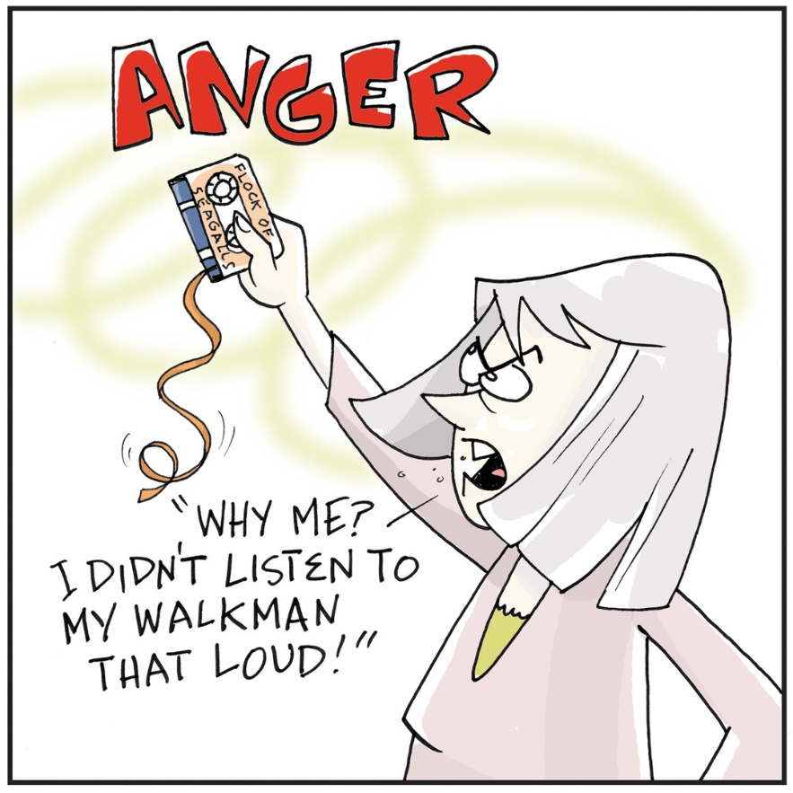
Hearing Loss Denial
There are three primary reasons for the patient/client to remain in denial of their condition. They are:
Hearing loss is insidious and generally occurs slowly over time.
The patient/client harbors anger about the origin of the loss.
The patient/client associates hearing loss with aging.

Slide 28
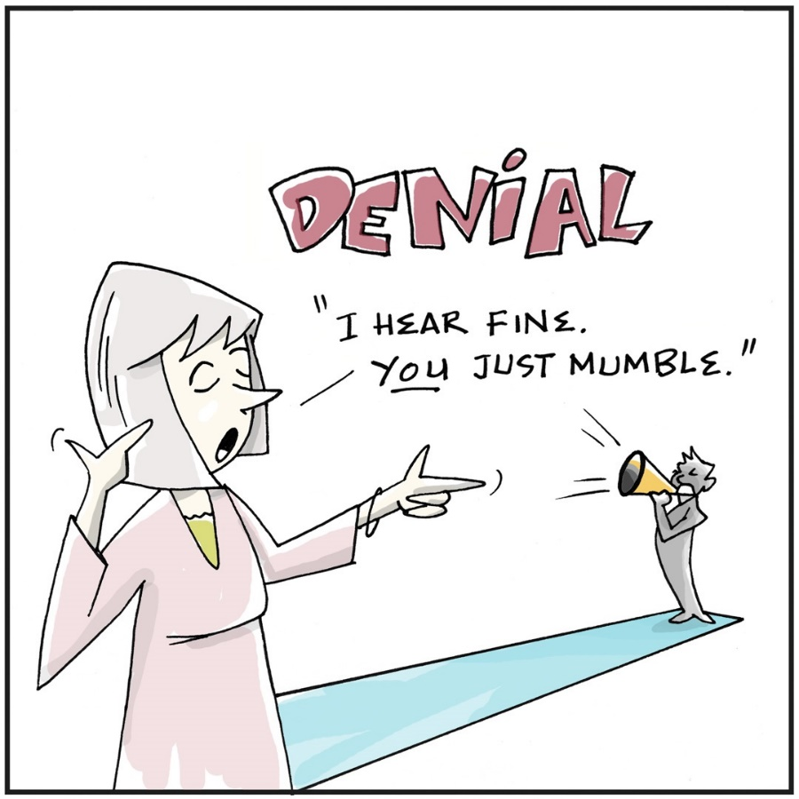
Opposition To Wearing Hearing Instruments
There are three primary reasons patient/clients are opposed to the use of hearing instruments. They are:
Hearsay (nobody wears them)
Costs (cannot afford them)
Stigma (people will believe I am handicapped)

Slide 29
Unless this opposition is recognized and addressed, the probability of treatment failure is increased!

Slide 30
Directed Discovery
The directed discovery process starts with this basic premise:
“Purchasing and wearing hearing instruments is an emotional decision. Unless dealt with effectively, emotions will sabotage the entire process.”

Slide 31
Directed Discovery
Directed discovery involves three critical thought processes. They are:
Attitudinal thinking
Analytical thinking
Objective thinking

Slide 32
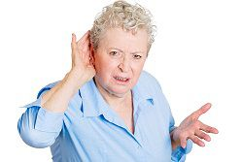
Attitudinal Thinking
Attitudinal thinking should define two patient/client’s attitudes regarding:
How do they feel about their hearing loss?
What are their concerns regarding the use of hearing instruments?

Slide 33
Analytical Thinking
Analytical thinking should define the pros and cons regarding:
The use of hearing instruments
The non-use of hearing instruments

Slide 34
Objective Thinking
Objective thinking is determined after the hearing tests. It involves:
Affirmation of hearing instrument necessity
Correction of any misperceptions as revealed by testing.
Additional information revealed regarding patient/client condition.

Slide 35
Two commonly used interview documents to validate hearing ability improvement:
Client Oriented Scale of Improvement (COSI)
Abbreviated Profile of Hearing Aid Benefit (APHAB)
You may use some of these pre-fitting questions while achieving your objective thinking directed discovery process.

Slide 36
With Directed Discovery
The goal of this process is to help the patient/client change their perception of their hearing loss in a collaborative manner.
The result will be a successful long-term patient/client relationship and outcome.

Slide 37
This directed discovery approach to successful patient/client outcomes must be clearly defined within consumerism in general.
First you have the general consumer within our population,
Second, you have a customer who is willing to spend time and access your specific offerings,
Third, you have the patient/client which has been created through your successful collaborative patient/client directed discovery process.
Let’s further define the customer in front of you. I will offer excerpts from Dr. Wayne Staab regarding his psychographic analysis.

Slide 38
Motivation (To Purchase)
Comes from understanding different personal values
If we can identify the ‘value’ system of a person, we can better motivate them to purchase
Essentially, I want to provide you with a proper (and simple) tool to accurately describe the customer’s values, and hence set the climate for more effective interaction
If you can ‘see’ what the customer wants, you can determine how to satisfy these wants

Slide 39
People purchase same product (i.e., hearing instruments), but for different reasons. The Goal:
Identify repetitive behavior in the consumer
Determine HOW PEOPLE ACT, not WHY
Their ACTION determines how you sell to that ACTION
Concentrate on the market as it IS, not on way you think of it
Determine how we see OURSELVES, and how we should relate our information to the customer

Slide 40
You must know the CUSTOMER
to know how to proceed!

Slide 41
DISC - Four quadrant behavioral model
Based on the work of William Marston Ph.D. (1893 - 1947) -Harvard University psychologist
Examines the behavior of individuals in their environment or within a specific situation
DISC looks at behavioral styles and behavioral preferences
✦ Dr. Wayne Staab’s Modification
Redirect Marston’s thoughts toward the hearing impaired
Use for appropriate motivation when: Selling, Communicating, Marketing, Promoting, Advertising, Interacting, Directed Discovery

Slide 42
DISC - As Used by Dr. Wayne Staab
Places hearing instrument customers into boxes (categories)
Based on overt (what you see) qualities only
Must be careful with this (not always in same box)
Says: For the same product (i.e., a hearing instrument), people buy for different reasons
Looks for repetitive overt behavior in the person involved, and uses this in the marketing process

Slide 43
DISC Behaviors Based on Overt Behavior:
What they do, not why they do it.
D
I
S
C
= Dominance
= Influence
= Steadiness
= Compliance

Slide 44
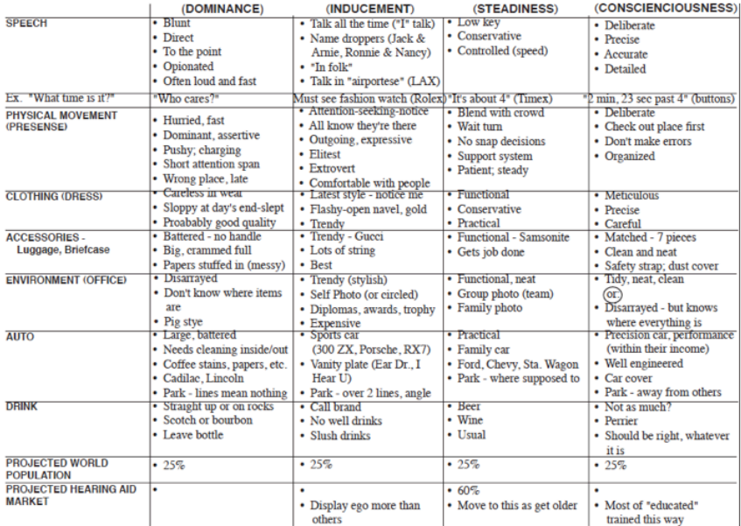

Slide 45
DISC Potential Problems
D & C = Trouble selling to each other
D & D = Battle, then do business
I & I = Nobody listens
I & D = I talks D out of sale Better Communications
DISC Better Communications
S & S = get along pretty well (why many like old line dealers – especially older people)
S & D = Do not get along.
D = pushy;
S = no fight
S & I = S doesn’t trust I, if I is too aggressive

Slide 46
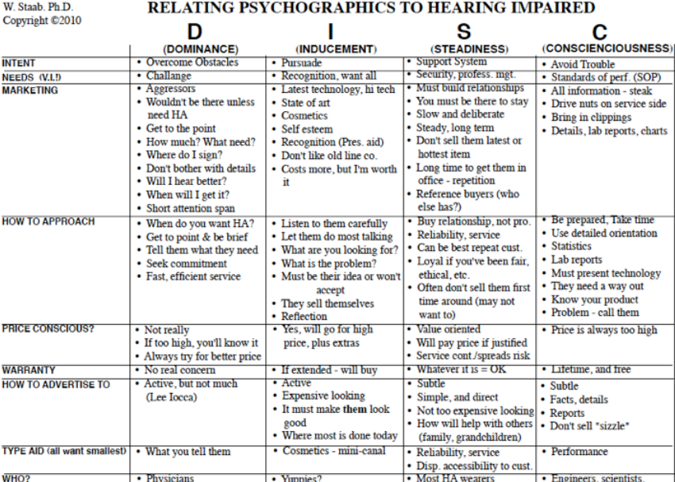

Slide 47
DISC Manufacturer Product/Marketing
High D = Aggressive Part of the Country?
High D = New York, New Jersey
High I = California
High S = Mid America
High C = Research areas

Slide 48
Do People Stay in One Group?
NO. Classifications are not static
People move from one attitude group to another in different circumstances
Some attitudes will change more frequently than others
Overlaps will always exist – this is a reality of consumerism

Slide 49
Next week Todd Allen will describe how to move your customer into a patient/client through the use of best practices and, of course, asking for the order and payment.

Slide 50

THANK YOU
ANY QUESTIONS?

