Slide 1

Cochlear Embryology & Otologic Disease
October 12, 2021

Slide 2

First Appearances/Otocysts
The inner ear first appears as a thickening of ectoderm—the auditory placode.
In the twenty-fourth day of embryo formation hollow cysts have formed-- otocysts (auditory vesicles)

Slide 3
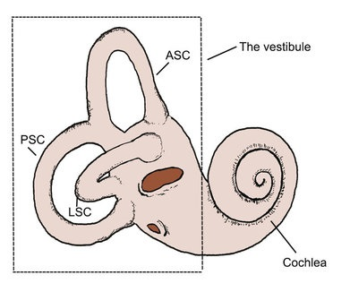
First Appearances/Otocysts
The otocysts soon become detached from the ectoderm from which they arose.
At that point where the otocyst has detached from the ectoderm, the endolymphatic sac begins to extend in the medial direction.

Slide 4
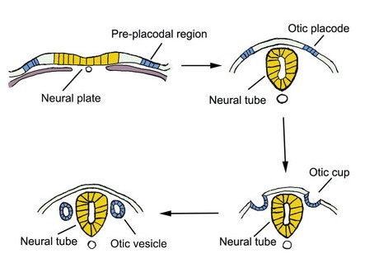
First Appearances/Otocysts
It continues to dilate; and this slender medial endolymphatic sac becomes the cochlear duct.
The dorsal portion begins to show indications of developing the semicircular canals (for balance).

Slide 5
First Appearances/Otocysts
By the end of the seventh week, the otocyst has been modeled roughly into the membranous labyrinth with its semicircular canals and a cochlea with one turn.

Slide 6
First Appearances/Otocysts
In the eighth week, the endolymphatic duct with the three semicircular canals are well defined and the utricle and saccule have been divided.
The cochlear duct has begun to coil into its familiar snail shell shape.

Slide 7
First Appearances/Otocysts
By the third month, the adult form of the inner ear has been nearly completed.
Its further development results in complete separation of the utricle and saccule which remains attached to the endolymphatic duct by a short slender canal.

Slide 8
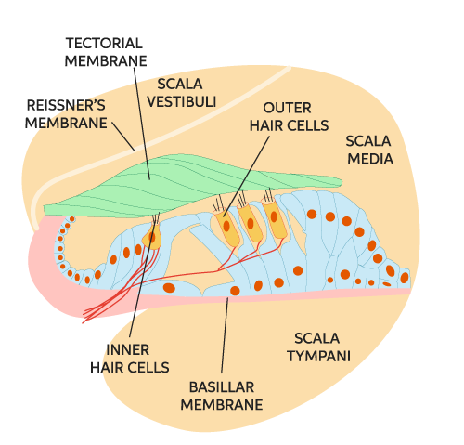
First Appearance/Tectorial Membrane
With the development of the membranous labyrinth, the spiral organ divides into an inner and outer ridge.
Both ridges become covered with an increasingly prominent tectorial membrane.

Slide 9
First Appearance/Hair Cells
In the area between these two ridges the epithelial cells begin to form the sensory hair cells.

Slide 10
First Appearance/Bony Labyrinth
The mesoderm surrounding the membranous (epithelial) labyrinth becomes differentiated into a fibrous membrane and later into cartilage.

Slide 11
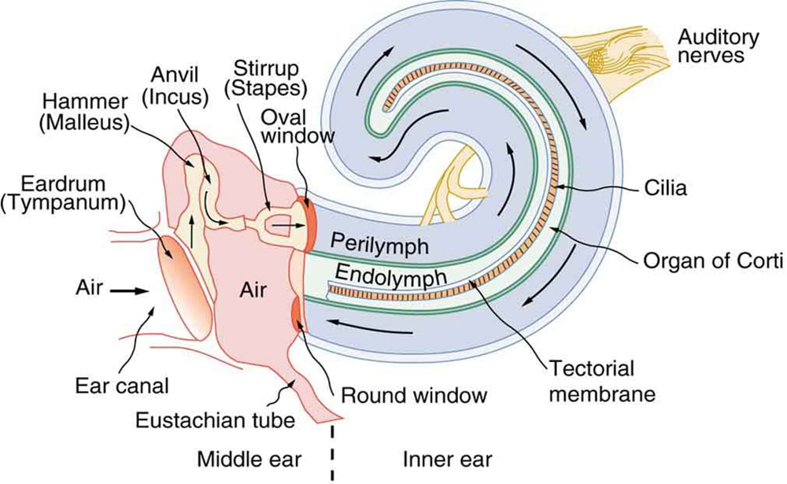
First Appearance/Perilymph
At about the tenth week, the cartilage immediately surrounding the membranous labyrinth undergoes a peculiar reversal of development.
It returns to a pre-cartilaginous condition in which the cells lose their boundaries.

Slide 12
First Appearance/Perilymph
This loose network of cells becomes the perilymphatic space surrounding the membranous labyrinth.
When this has taken place, the membranous labyrinth becomes suspended in the fluid of the perilymphatic spaces.

Slide 13
First Appearance/Perilymph
The perilymphatic spaces continue to develop above and below the cochlear duct creating the upper (scala vestibuli area) and the lower (scala tympani area).

Slide 14
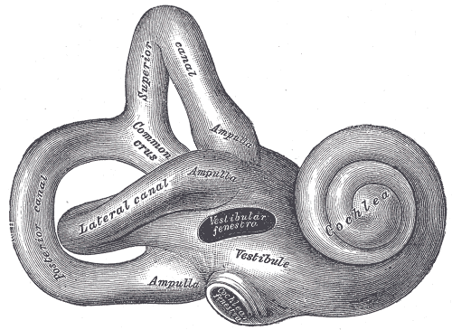
First Appearance/Bony Labyrinth
By the fifth month, the cartilage surrounding the membranous labyrinth has become the bony labyrinth (the hardest bone in the human body).
Thus, by the middle of fetal life, the inner ear has attained its full adult size.

Slide 15
Now that we are aware of how the inner ear is formed inside the womb, we can become more aware of how the mother’s health conditions may affect the development of the fetus’s inner ear.
This cochlear area is also where we will work extensively, when providing hearing “treatment” to an adult with cochlear damage.

Slide 16
Whether it is a pre-natal malformation of the cochlea or damage in adulthood, the inner ear is an area that we must fully understand when applying electroacoustic stimulation.
Let’s better understand the insults which may arise through Otologic disease.

Slide 17
External Ear Disease
Lesions of the Pinna encountered are:
Hematoma (blood between the cartilage and skin)
Frostbite (portions of the Pinna appear white and feel solid to the touch)
Keloid (excessive scar tissue formation)

Slide 18
External Ear Disease
Infectious lesions of the Pinna are not common. Here are a few:
Cellulitis (infectious inflammation)
Sub-perichondral abscess (a contaminated wound)

Slide 19
External Ear Disease
Neoplastic tumors (skin cancers) of the Pinna are common. Many are benign—few are malignant.
Any lesion which is bleeding, not symmetrical in shape, or includes various colors should be referred to a dermatologist.

Slide 20
External Ear Disease
Commonly encountered skin lesions are:
Senile Keratosis
Squamous Cell Carcinoma
Basil Cell Carcinoma
Malignant melanoma (it is rare but extremely aggressive)

Slide 21
External Ear Disease
Congenital lesions represent abnormal shape and size of the Pinna, and/or portions of it.
Note: when these abnormalities are observed, they may provide a possible clue to defects hidden within the middle ear.

Slide 22
External Auditory Canal Disease
Traumatic disease of the external auditory canal commonly occur due to the patient or physician trying to extract a foreign body from the ear canal.
Deep lacerations may become infected if not treated appropriately.

Slide 23
External Auditory Canal Disease
The most common disease condition is External Otitis.
However, there is a viral condition—Bullous Myringitis--which reveals an inflamed/red tympanic membrane and is associated with sensorineural hearing loss.

Slide 24
External Auditory Canal Disease
Skin cancers may also be found inside the ear canal. More commonly found will be benign growths such as:
Keratosis Obturans (a skin ball)
Exostosis (a nodule of bone covered with skin close to the eardrum)
Osteoma ( a nodule of bone covered with skin found closer to the second bend of the ear canal)

Slide 25
External Auditory Canal Disease
Congenital abnormalities may be found regarding the ear canal.
Two forms found are:
Membranous Atresia (tissue “plug”)
Bony Atresia (bony “plug”)

Slide 26
Middle Ear Disease
Trauma of the TM or ossicles often occurs from:
An explosion
A puncture
A burn
Note: A severe enough trauma may also fracture the temporal bone and result in a fistula (cerebrospinal fluid leak).

Slide 27
Middle Ear Disease
Infectious disease encountered within the middle ear are commonly:
Suppurative Otitis Media (either acute or serous)
Acute Mastoiditis (a condition which occurs when otitis media goes untreated)

Slide 28
Middle Ear Disease
Benign growths may also occur within the middle ear. Some common growths are:
Cholesteatoma (enlarged section of skin tissue)
Osteomas (benign bony growths)
Glomus Tumors (a reddish-blue mass seen through/behind the eardrum often associated with pulsatile tinnitus)

Slide 29
Middle Ear Disease
Congenital disease of the middle ear often includes:
Fixation of the Stapes
Ossicle’s absence
Fusion of ossicles to the temporal bone

Slide 30
Diseases of the Inner Ear
Trauma and aging include:
Noise induced hearing loss
Presbycusis (old age hearing loss)
Fractures of the temporal bone

Slide 31
Diseases of the Inner Ear
Infectious disease of the inner ear is either viral or bacterial. Sensorineural hearing loss and various forms of labyrinthitis are associated with this process. They are:
Bacterial labyrinthitis (infection from temporal bone fracture)
Viral labyrinthitis (caused by mumps, measles, influenza)
Syphilitic labyrinthitis (serious form of bacterial either congenital or acquired)

Slide 32
Diseases of the Inner Ear
Benign growths within the inner ear generally occur within or along the internal auditory canal.
They are known as:
Acoustic Neuromas
Note: A less common benign growth occurring along the lining of the braincase in known as a Meningioma.

Slide 33
Diseases of the Inner Ear
Congenital defects fall into three general categories. They are:
Pre-natal (maternal ototoxicity, maternal syphilis, congenital rubella)
Neonatal (low birth weight, hypoxia, serious infections i.e. meningitis, encephalitis)
Post-natal (genetic syndromes)

Slide 34
Diseases of the Inner Ear
Two common diseases often associated with fluctuating hearing loss and affecting the inner ear are:
Meniere’s Disease (triad of symptoms i.e. fluctuating hearing, tinnitus, vertigo)
Multiple Sclerosis (unsteadiness, fluctuating sensorineural HL, and visual disturbances)

Slide 35
Ototoxicity—Not a Disease - will be covered in a future presentation.
We will provide more information regarding ototoxicity and its effects upon the inner ear, from the insults of life/lifestyle.

Slide 36

THANK YOU
ANY QUESTIONS?

